Slide 1
OPTIMIZING IT SUPPORT TEAM PERFORMANCE ANALYTICS
INFOSYS SPRINGBOARD INTERNSHIP 6.0
PRESENTED BY
ANJANA KRISHNAN K

Slide 2
Project analysis slide 2
INTRODUCTION
In today’s digital environment, efficient IT support is essential for maintaining seamless business operations and ensuring customer satisfaction. Organizations handle large volumes of support tickets daily, making it necessary to analyze and optimize support performance. This project focuses on analyzing IT support ticket data to identify patterns, improve resolution efficiency, and enhance overall service quality. By leveraging data analytics and visualization techniques, the study aims to uncover operational bottlenecks and provide actionable insights for improving support workflows.

Slide 3
Project analysis slide 3
OBJECTIVES
Identify key performance trends in support operations
Understand patterns in customer issues and requests
Provide actionable insights for better decision-making
Optimize ticket resolution time .
Improve service efficiency

Slide 4
Project analysis slide 4
DATA SET DESCRIPTION
The dataset used in this project is sourced from an internal IT support system and contains approximately 8,469 records.
Key Attributes:
Ticket ID
Ticket Type (Request, Incident, Problem)
Ticket Priority (Low, Medium, High)
Ticket Channel (Email, Chat, Phone, Social Media)
Ticket Subject (Issue category)
First Response Time
Time to Resolution
Tasks
Schedules
Customer Objectives
Resources

Slide 5
Project analysis slide 5
TECH STACKS
The project was implemented using the following tools and technologies:
Data Handling: pandas, numpy.
Dataset Preparation: MS Excel
Visualization: matplotlib, seaborn.
Dashboard: Power BI.
Documentation: Jupyter Notebook, PDF Report, GitHub Repository, MS Word

Slide 6
Project analysis slide 6
MODULES IMPLEMENTED
Module 1: Data Acquisition and Understanding .
Module 2: Data Cleaning and Feature Engineering.
Module 3: Exploratory Data Analysis (EDA)
Module 6: Dashboard Development .
Module 5: Category & Channel-Level Insights.
Module 4: Performance and Trend Analysis

Slide 7
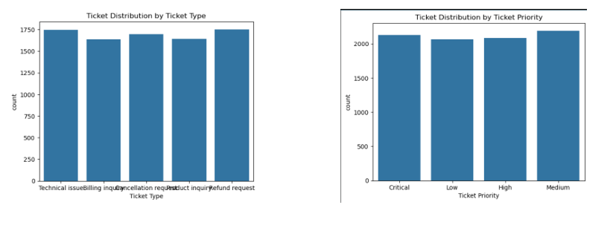
Project analysis slide 7
VISUALS & ANALYSIS
Key Visualizations:

Slide 8
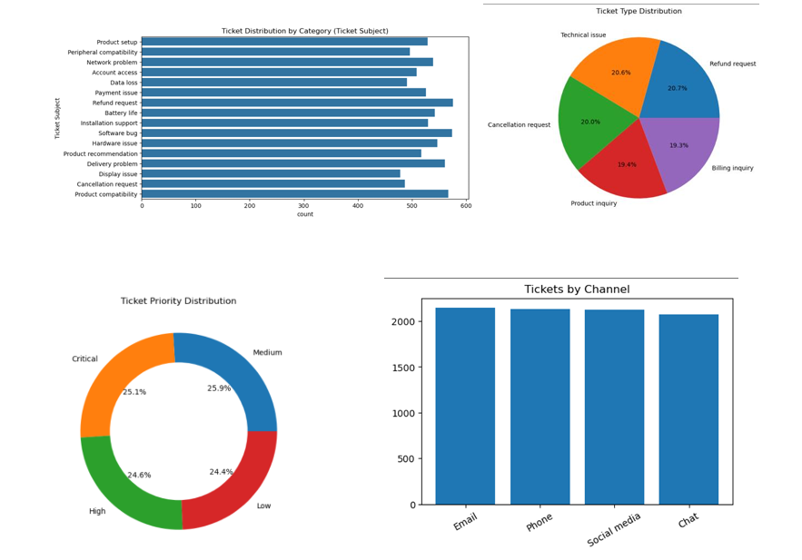
Project analysis slide 8

Slide 9
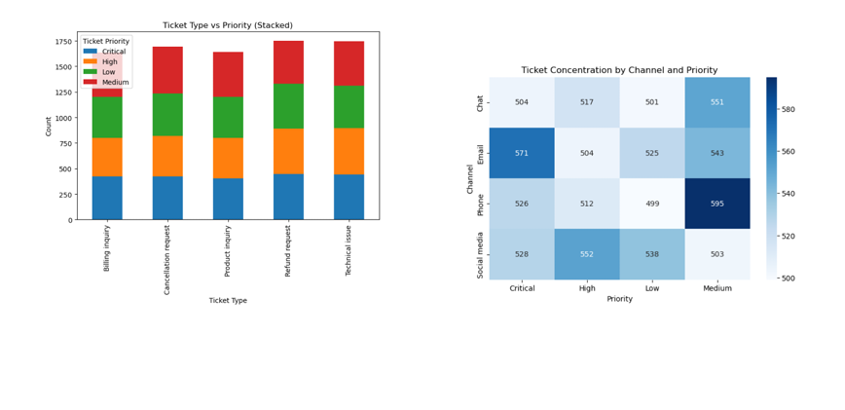
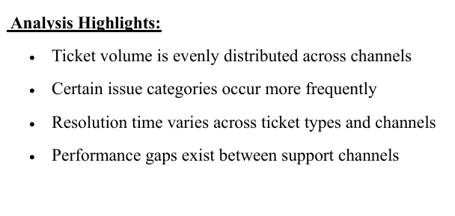
Project analysis slide 10

Slide 10
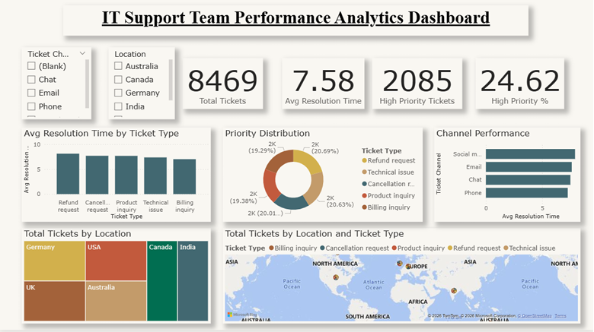
FINAL DASHBOARD

Slide 11
Key Features:
KPI Cards: o Total Tickets o Average Resolution Time o High Priority Tickets o High Priority %
Interactive filters (slicers)
Channel performance comparison
Category and priority distribution
Heatmap visualization
Geographic representation (simulated) The dashboard enables users to quickly analyze performance metrics and identify areas for improvement.

Slide 12
KEY INSIGHTS
Average resolution time is approximately 7.5 hours
High-priority tickets represent a significant portion of total tickets
Some support channels resolve issues faster than others
Billing and technical issues are the most frequent categories
Resolution efficiency varies based on ticket type and channel
High-priority unresolved tickets indicate potential bottlenecks 9. CONCLUSION

Slide 13
. CONCLUSION
This project successfully demonstrates how data analytics can be used to improve IT support operations. By analyzing ticket data, key performance trends and inefficiencies were identified.
The insights derived from this analysis can help organizations:
• Improve response and resolution times
• Optimize resource allocation
• Enhance customer satisfaction Overall, the project highlights the importance of data-driven decision-making in optimizing IT support performance.

Slide 14
Thank You

